Slide 2
Picking the Data
Based on current events, climate change and sustainability is at the forefront of politics. As a result, seeing what correlation between population and emissions existed, if any. The countries were picked based on what data could be pulled from Quandl. From this source, the years available were 1990 to 2018. Population was pulled from The World Bank, for the same time period.
Notes:
Emissions are measured in kt CO₂ equivalent

Slide 3
Initial Goals
Data connected in database (SQL)
Calculate population for 2020, 2021, and 2050
Calculate emissions for 2019, 2020, 2021, and 2050

Slide 4
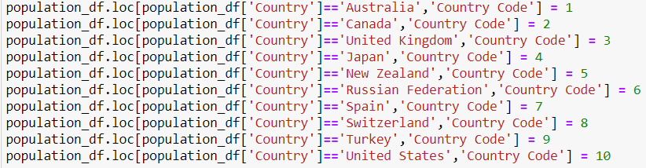
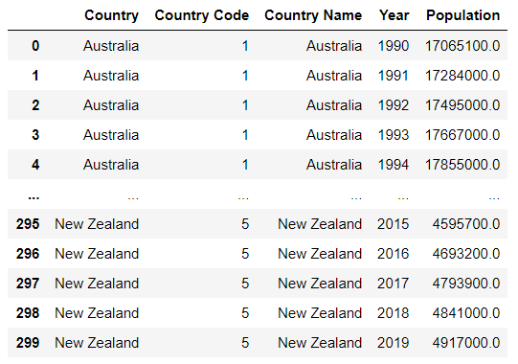
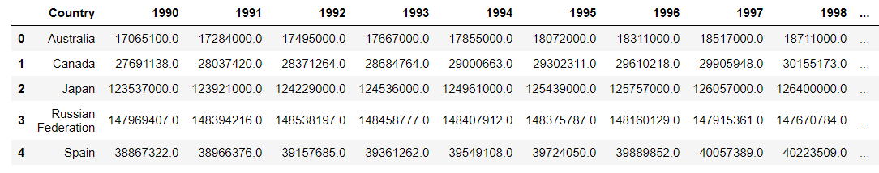
Preparing the Data for the Database and Tableau
Using Python, we cleaned the data and transformed it into a usable format
Country_Code: field added to use as a relational key between the Population and Emission tables
Population table: re-formatted the table to match the Emissions data table format for ease of use in Tableau

Slide 5
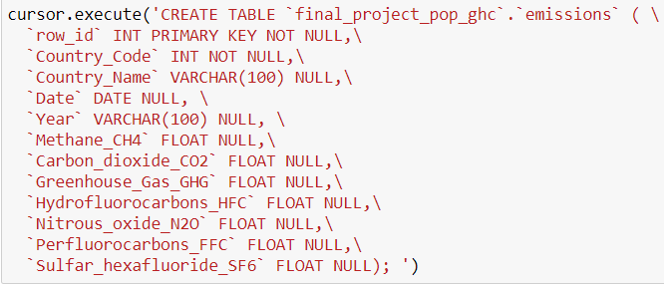
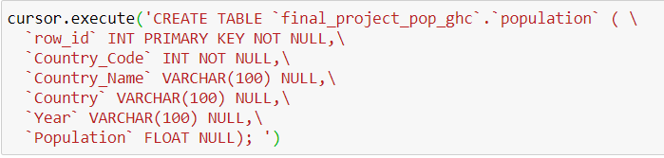
Python MySQL Connection to Create Database
Using the “mysql.connector” Python package, we created a database and both tables. Then, added the data row-by-row into the tables.

Slide 6
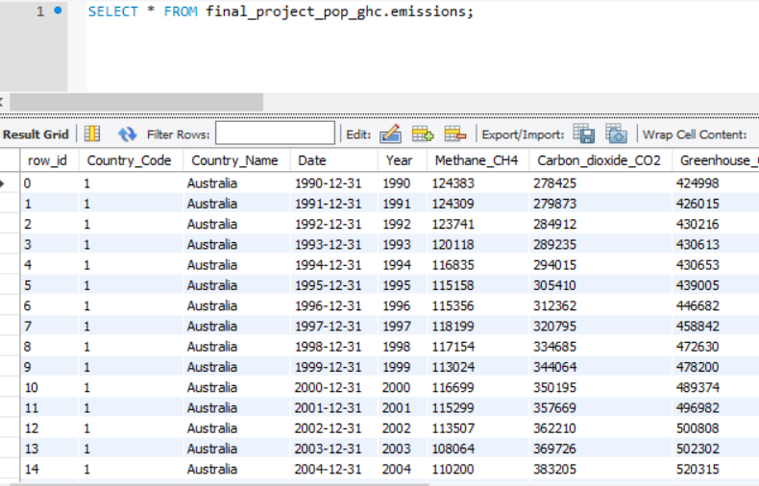
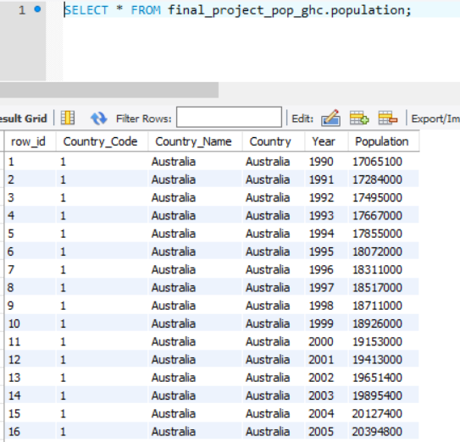
Successful Database Connection

Slide 7
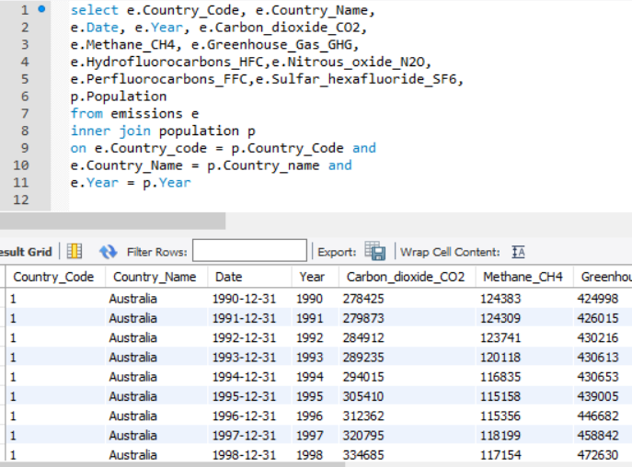
Query to Join the 2 Tables to Create Extract for Tableau

Slide 8
Basic Visualizations of Our Population and Emissions Data

Slide 9
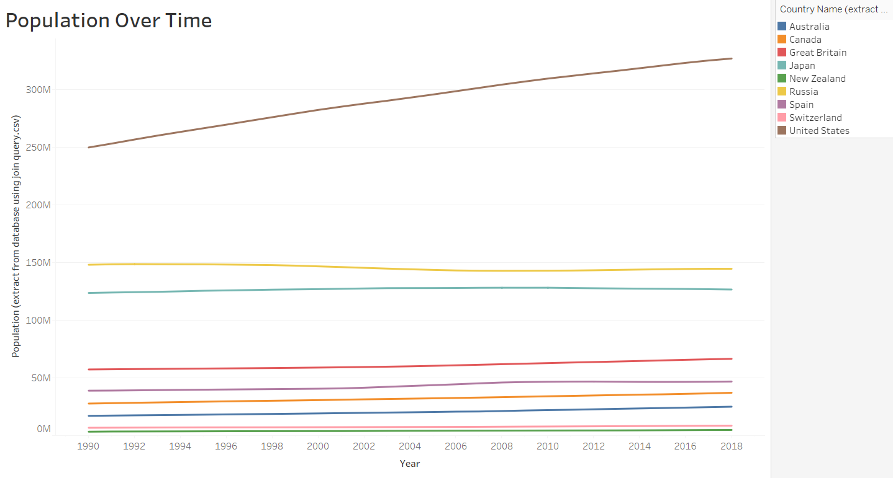

Slide 10
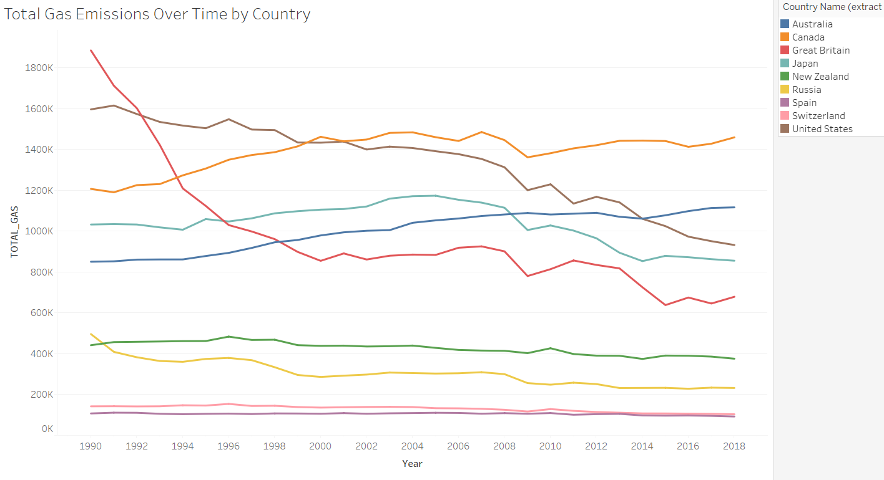

Slide 11
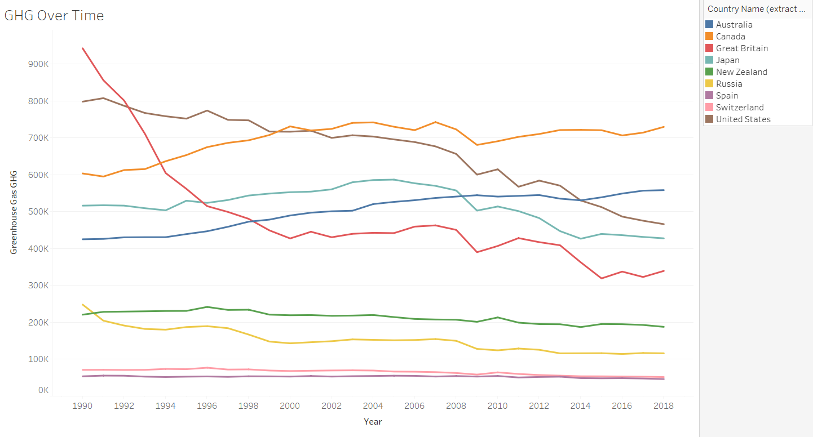

Slide 12
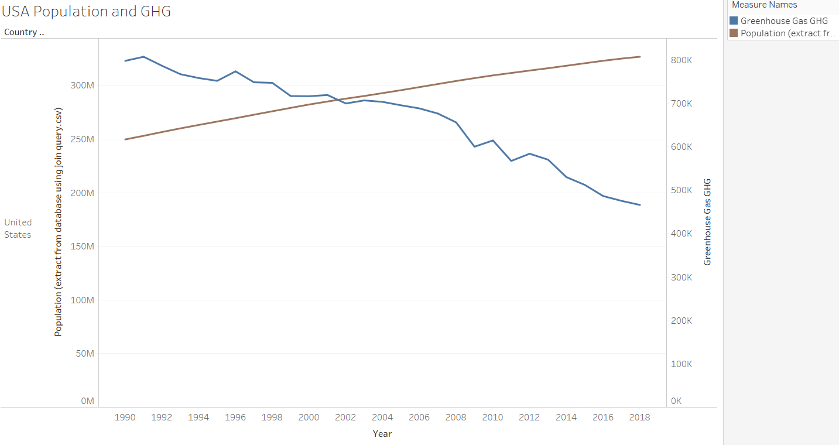

Slide 13
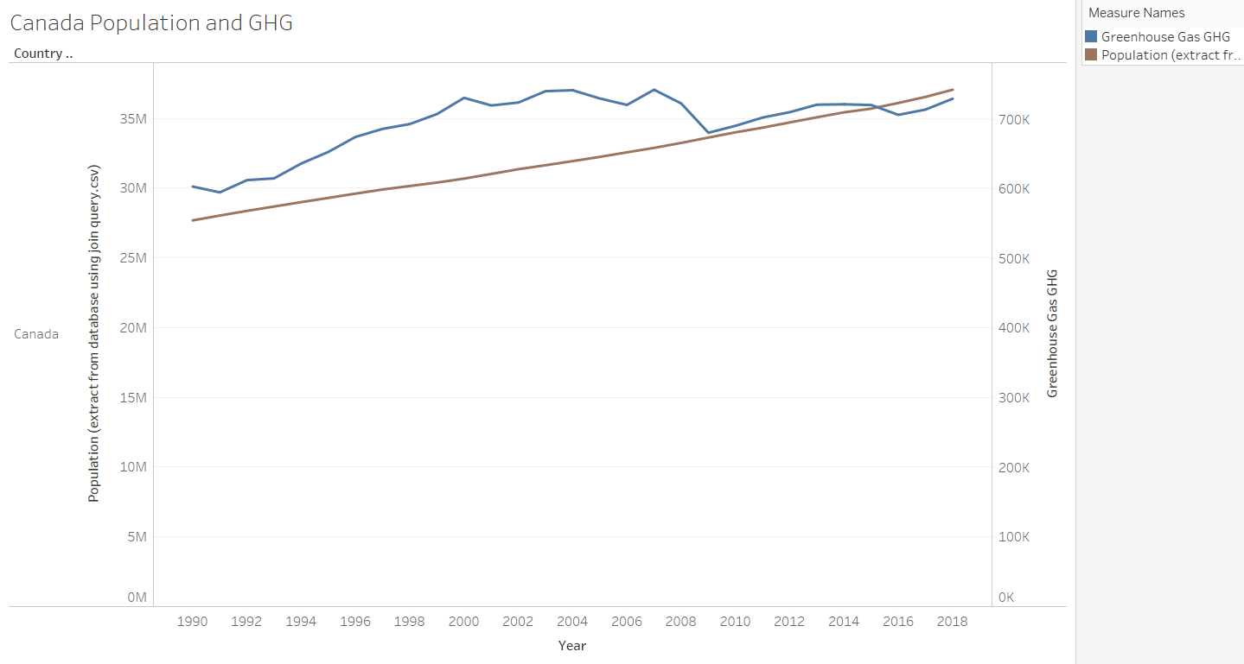
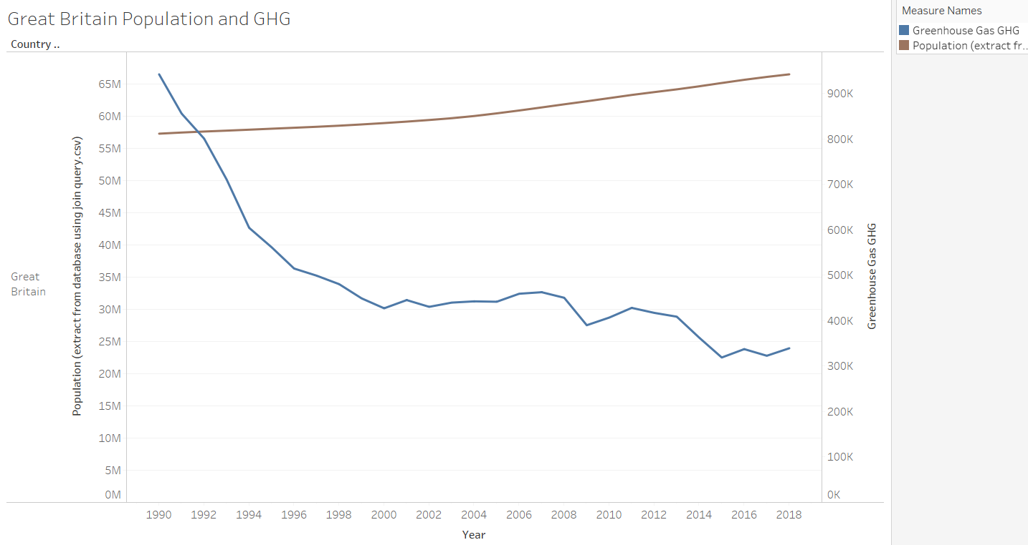
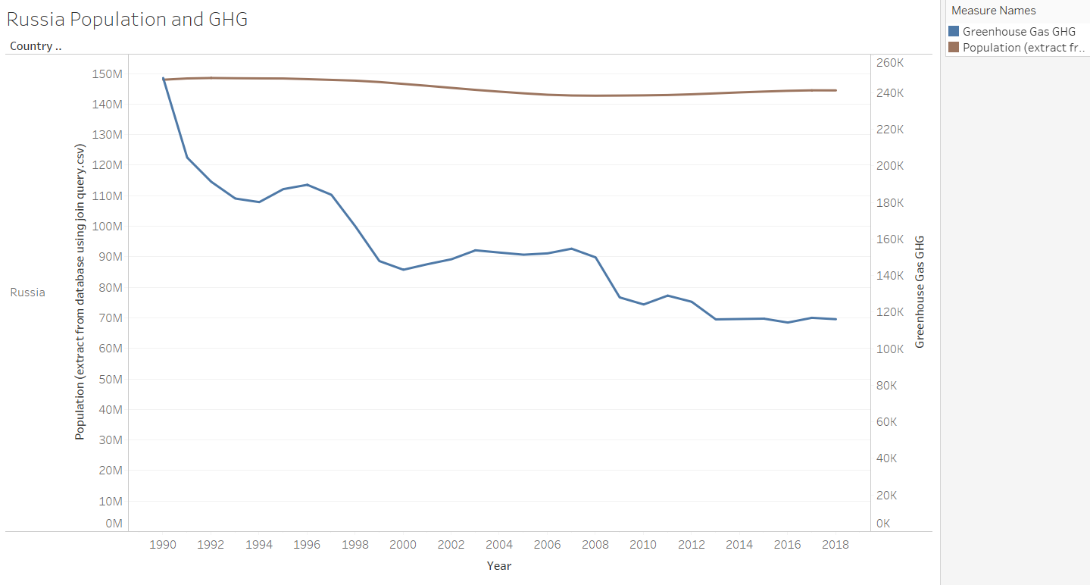
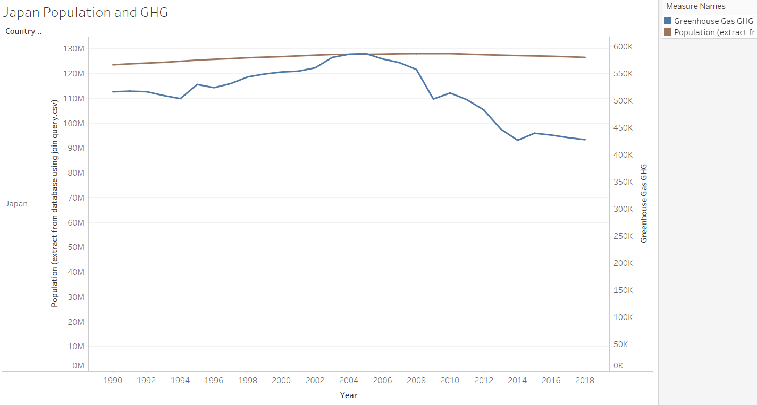

Slide 14
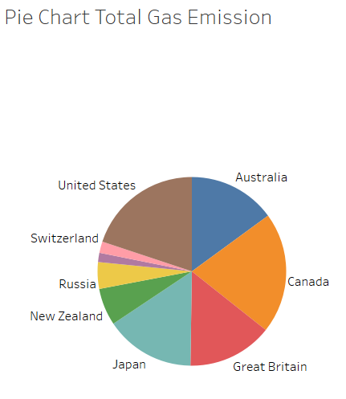

Slide 15
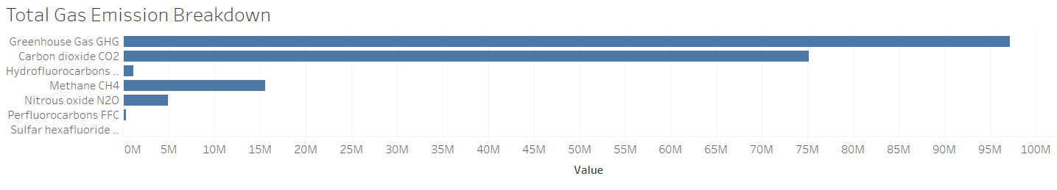
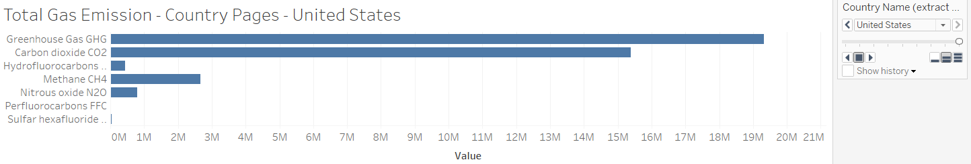
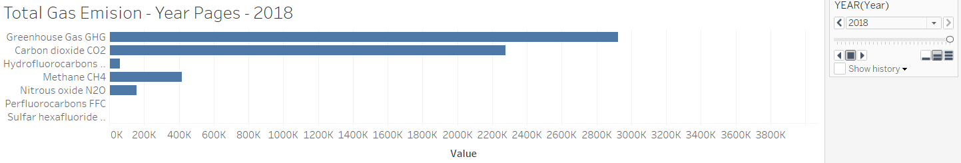

Slide 16
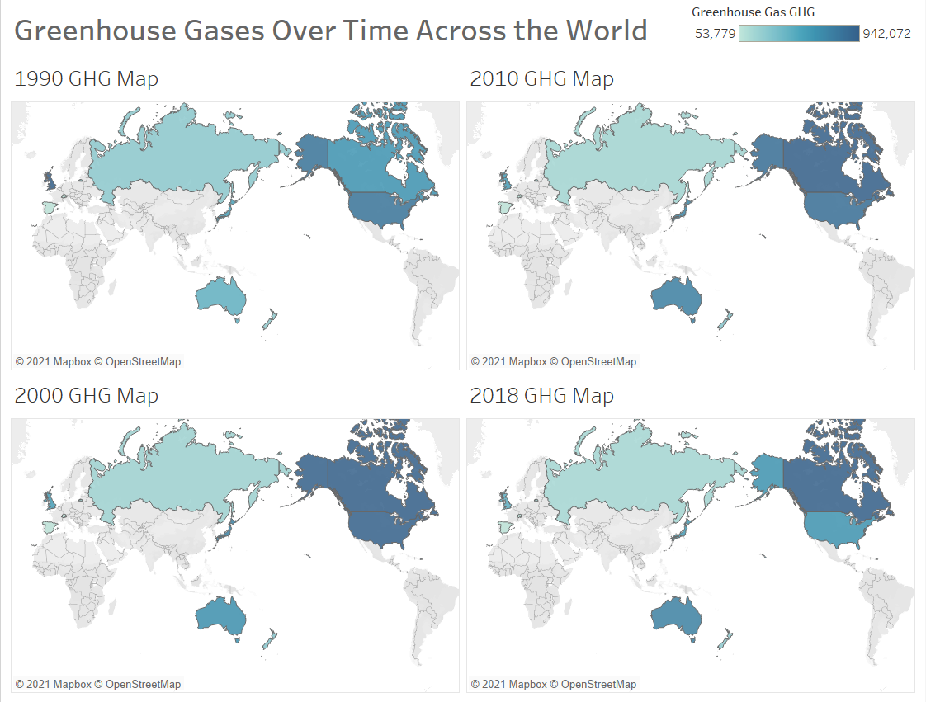

Slide 17
Machine Learning:
Predicting Population
and Gas Emission

Slide 18
Machine Learning - Population
During the process of machine learning, advice was given to change the focus of what the results should be at the end of the project. As there were many variables which may or may not be linked, population was the first variable to be explored. As inferred by the numbers, before any analysis, population looked to be linear. The approach was then to see how well population could be predicted. Model scores for training and testing were calculated. The results showed that training scores were fairly accurate, from 89.5 to 99.9. However, testing scores were wildly inaccurate, ranging from -82.56 to 87.5. An in-depth look at actual population growth over the time period shows there was a drop, but then begins to rise again. This correlates with the wildly inaccurate scores, as testing was based on 2010 - 2019, whereas training was from 1990 - 2009.
Notes:
Scores are r^2

Slide 19
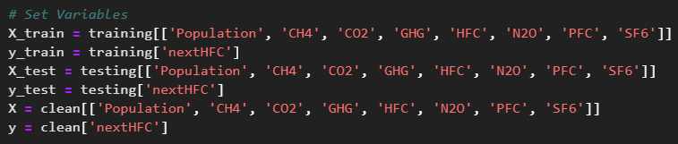
Machine Learning - Emissions
As previously stated, advice was given to change the focus of the project. This led to a change in how the emissions data was analyzed. This meant that a lag was required to aid in predicting the next year’s emissions. All factors were combined into the ‘X’ variable to predict the next ‘y’.

Slide 20
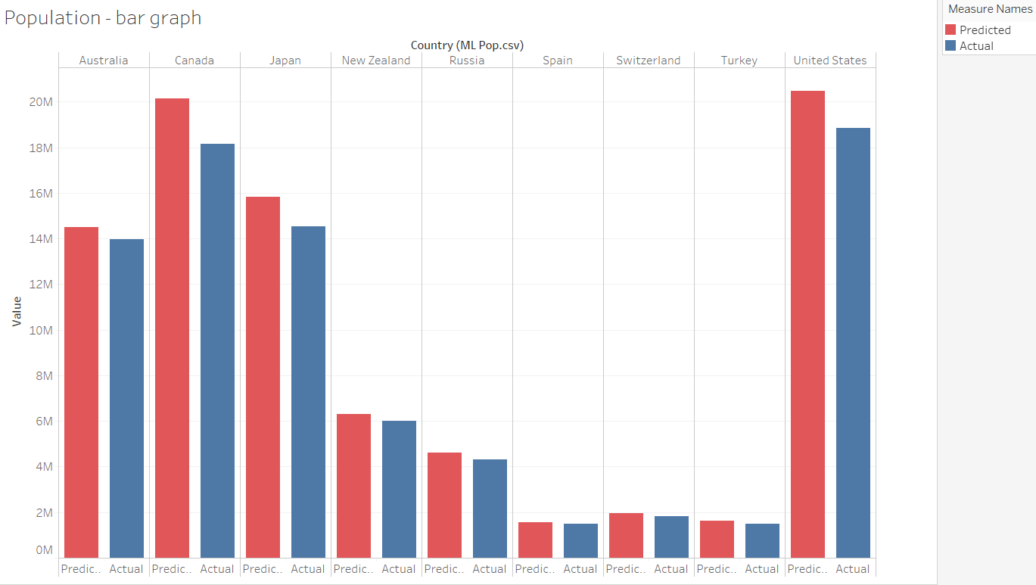
Machine Learning Model Results - Population

Slide 21
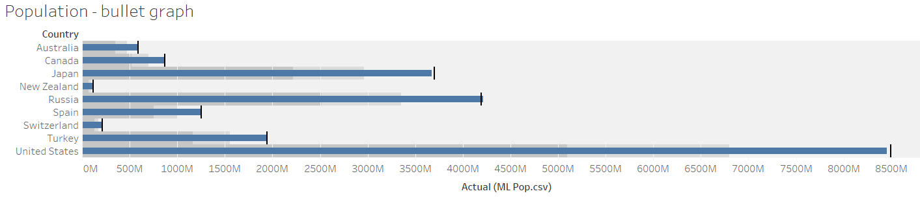
Machine Learning Model Results - Population

Slide 22
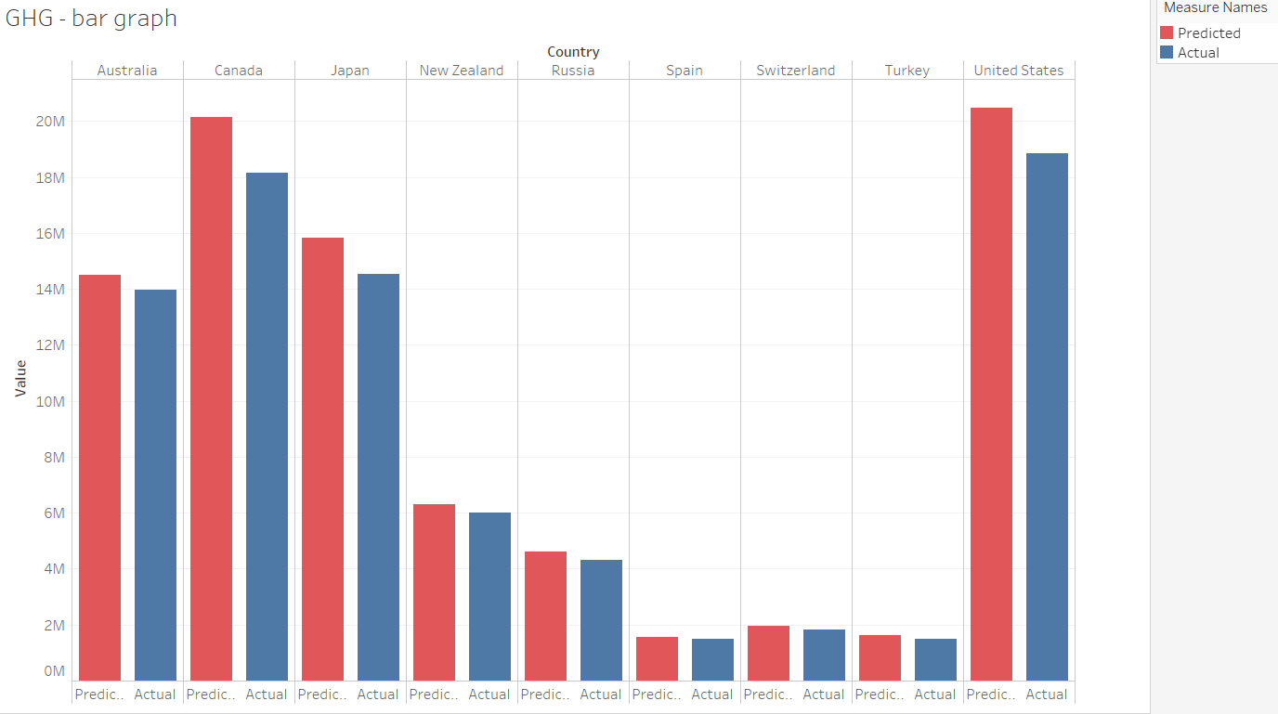
Machine Learning Model Results - Greenhouse Gas

Slide 23
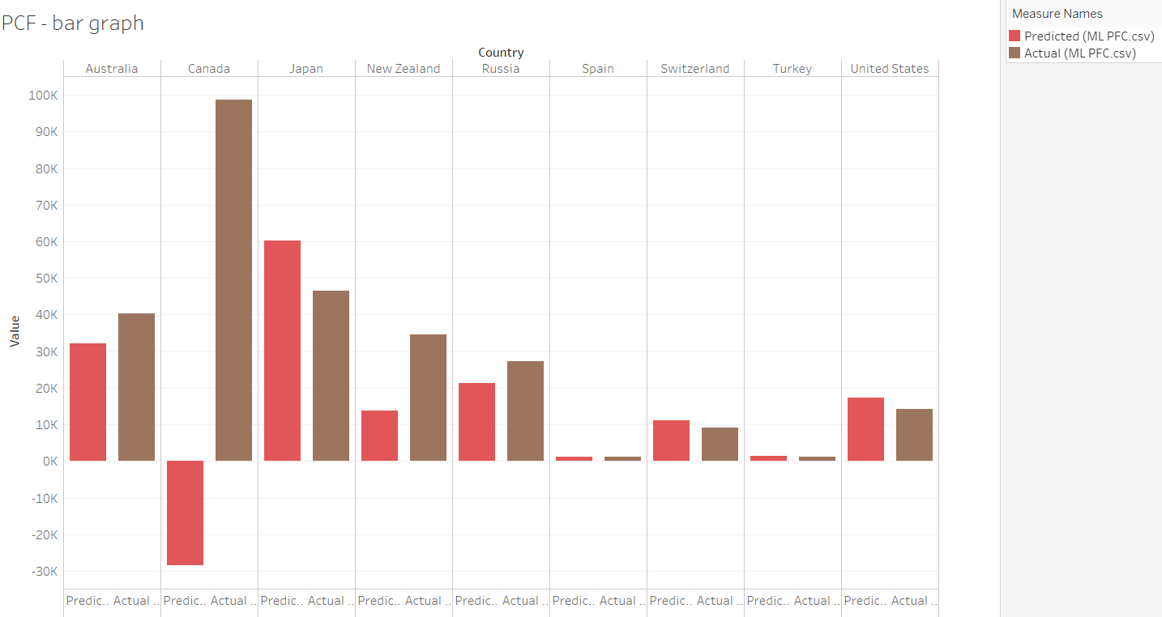
Machine Learning Model Results - Perfluorocarbons

Slide 24
Sources
Greenhouse Gases (GHGs): Quandl
Provided by: UNFCCC
Population: The World Bank

